Slide 1


Lesson 10
The power of colours
UNIT 3

Slide 2

What are primary and secondary colours?
Can you name 3 main primary colours?
Do you know any secondary colours?
Divide into three teams and make your own colour palette.
Visit this website and create the perfect palette that will represent your group. https://coolors.co/
Write a short description of your group’s palette.
Which member of the team chose which colour and why? Describe what your palette represents.
Give your palette a name.
Have fun! ☺

Slide 3
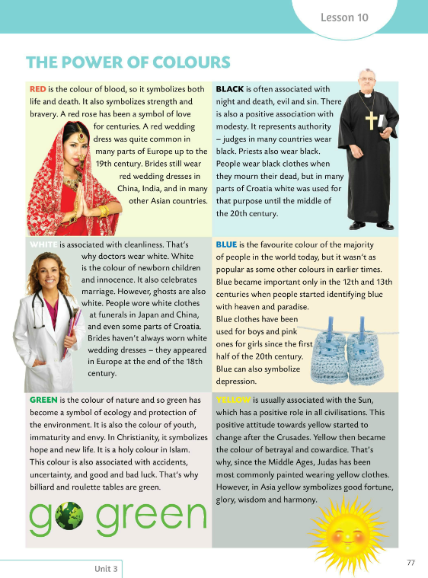
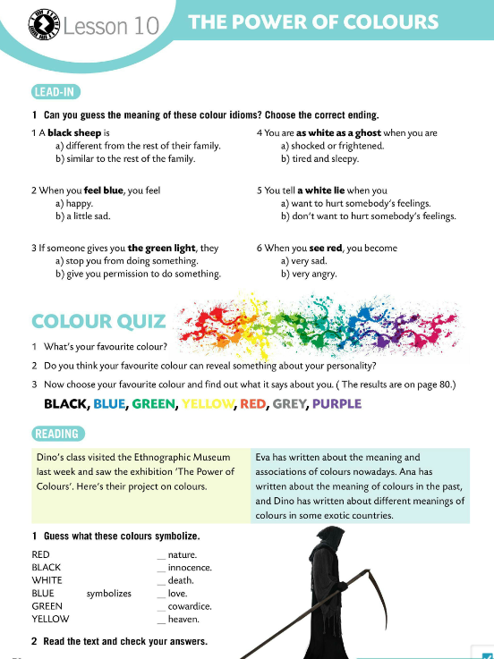
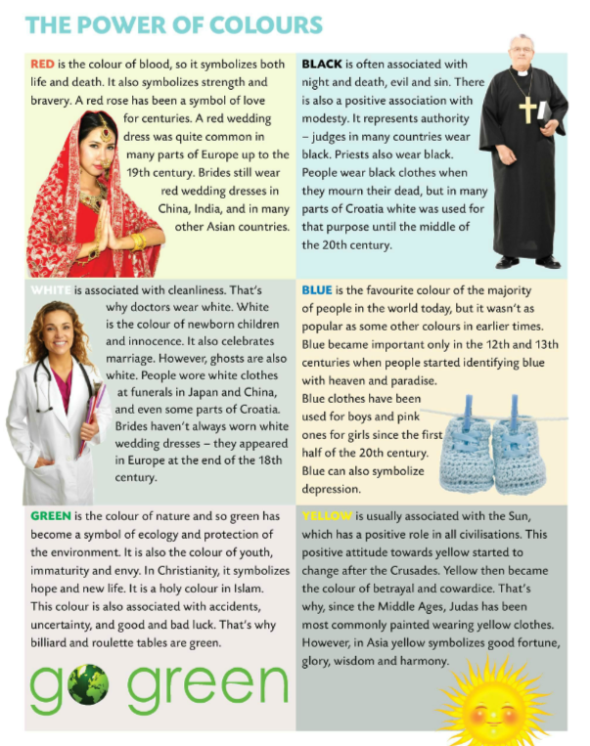
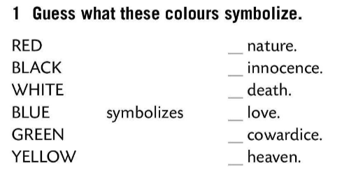
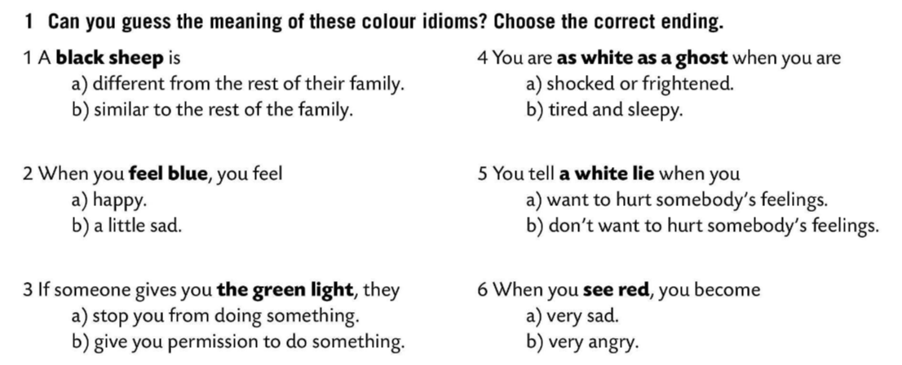
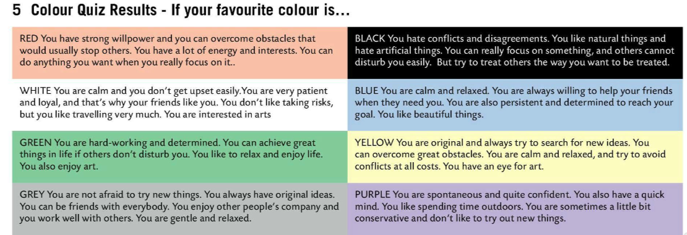
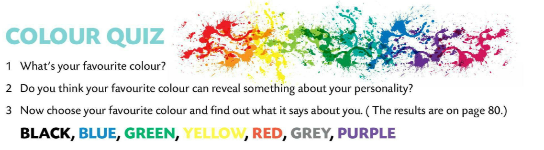
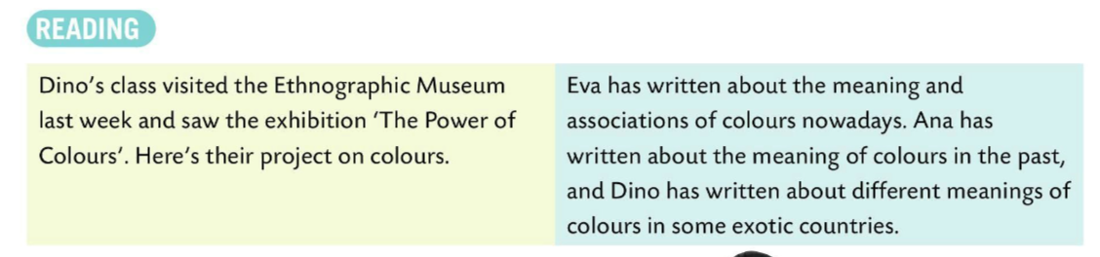
Can you guess the meaning of these idioms? Choose the correct ending.
Check.
Do the colour quiz. Then see what your favourite colour says about you.
GREEN
WHITE
BLACK
RED
YELLOW
Read the introduction and find out what Dino, Eva and Ana were doing.
BLUE
Guess what these colours symbolize.
Read the text and check your answer.
Check.

Slide 4
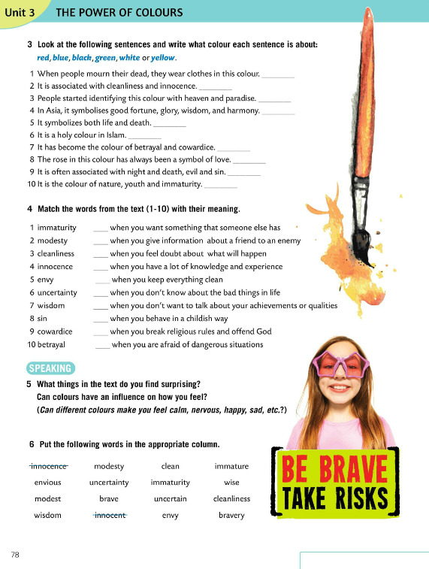
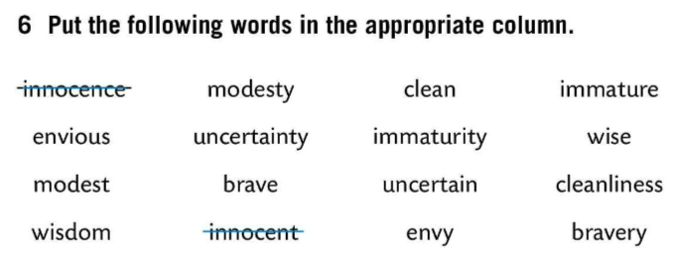
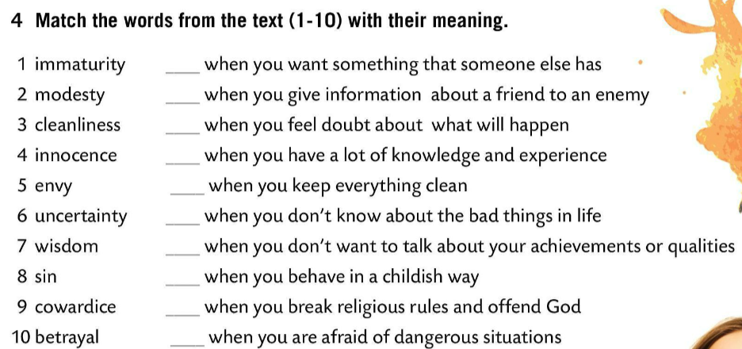
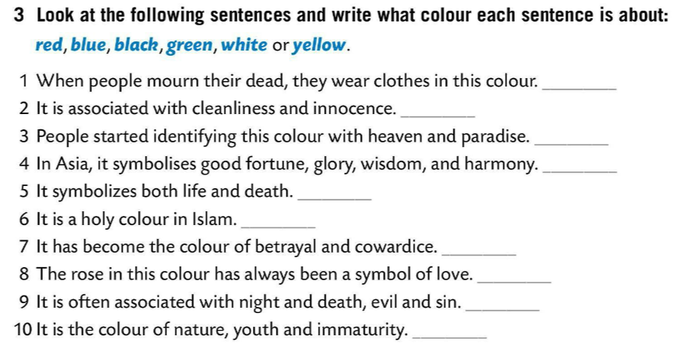
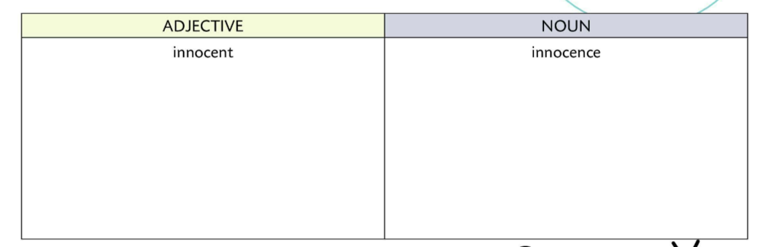
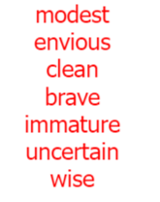
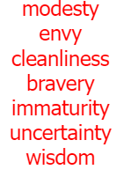
Look at the following sentences and write what colour each sentence is about.
Check.
5
Match the word from the text (1-10) with their meaning.
10
BLACK
6
WHITE
BLUE
7
YELLOW
3
Check.
RED
4
GREEN
2
YELLOW
What things in the text do you find surprising? Can colours influence on how you feel?
1
RED
8
BLACK
9
GREEN
Put the following words into appropriate column.

Slide 5
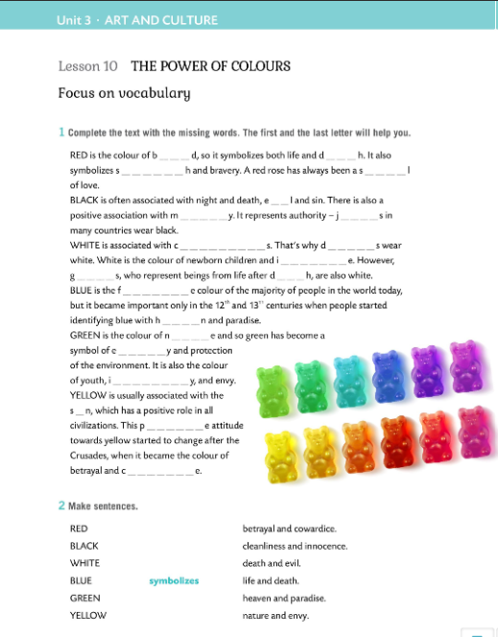

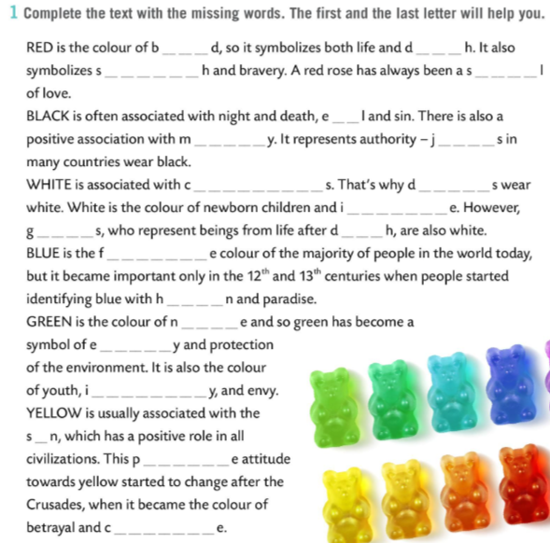
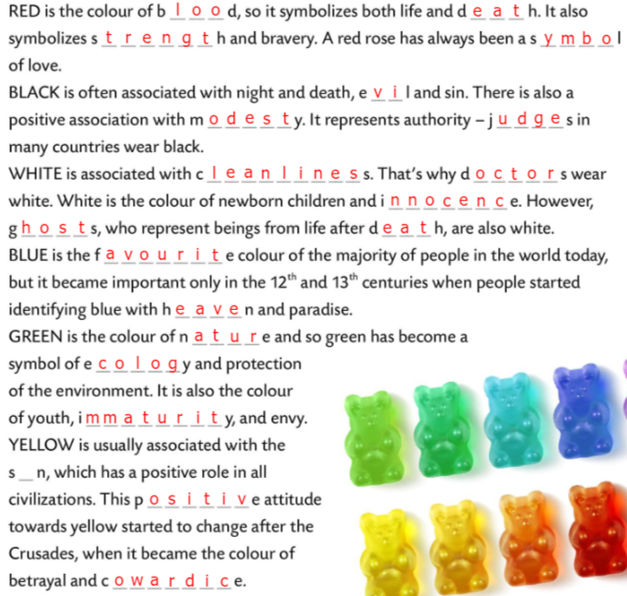
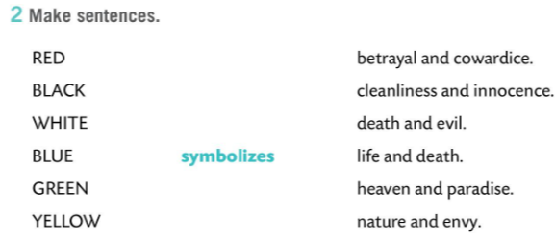
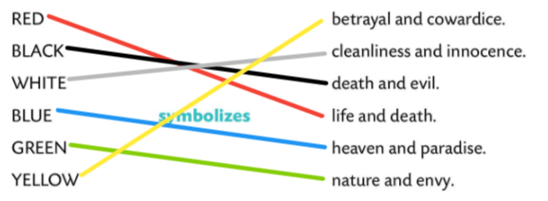
Workbook, page 66
Complete the text with the missing words. The first and the last will help you.
Check.
Make sentences.
Check.

Slide 6
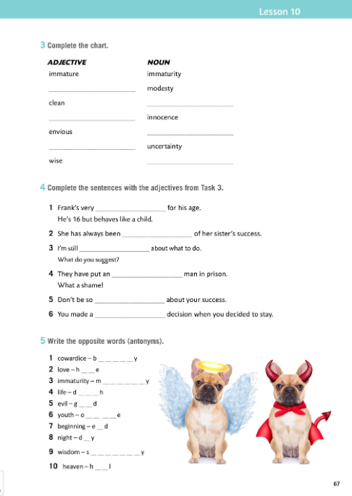
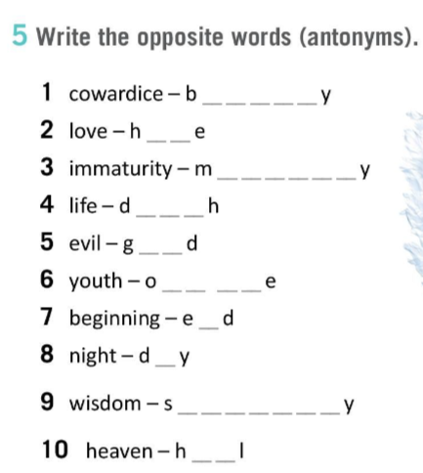
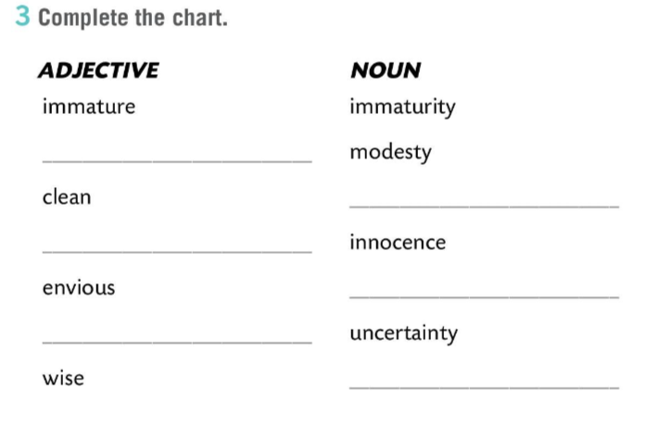
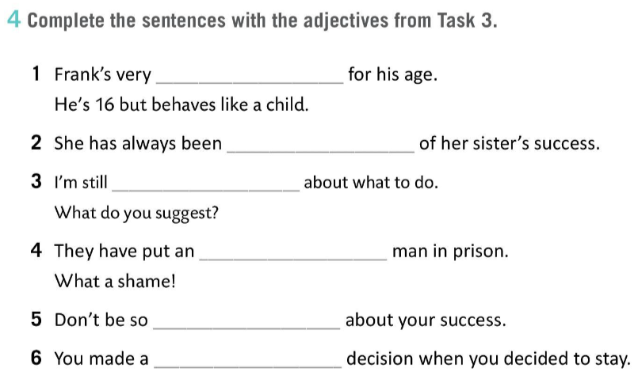
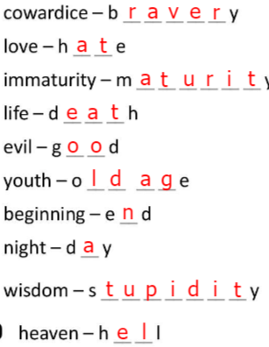
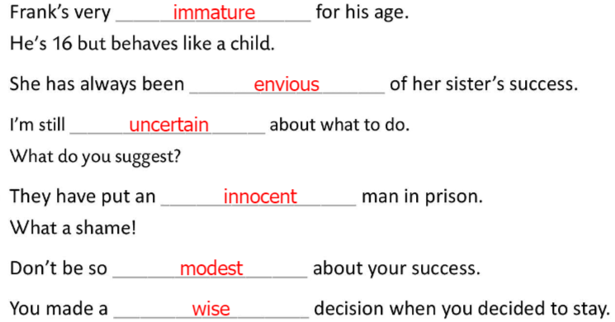
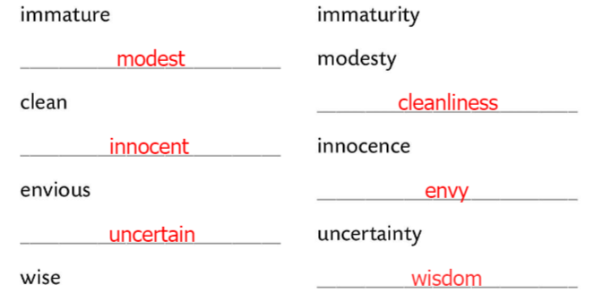
Workbook, page 67
Complete the chart.
Check.
Complete the sentences with the adjectives from Task 3.
Check.
Write the opposite words (antonyms).
Check.

Slide 7
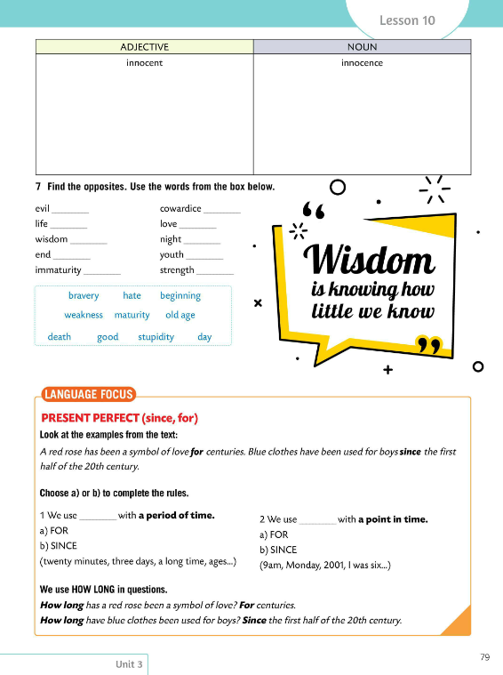
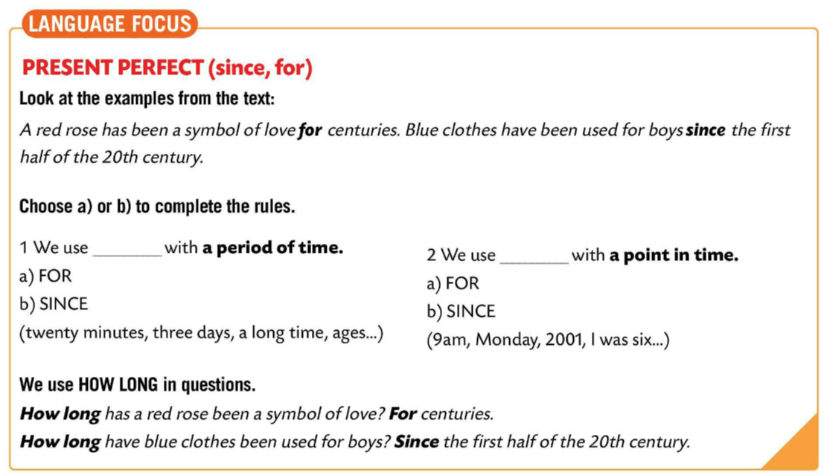
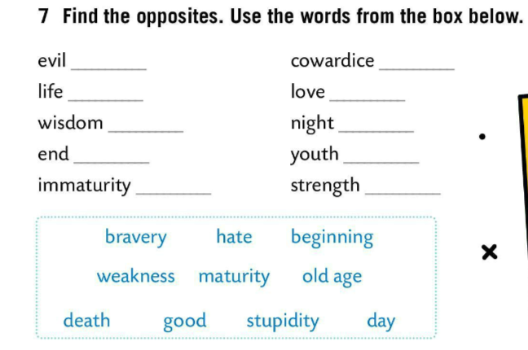
Find the opposites. Use the words from the box below.
Check.
evil – zlo, cowardice – kukavičluk, wisdom – mudrost, youth – mladost, immaturity – neozbiljnost/nezrelost, strength – snaga, bravery – hrabrost
good
bravery
death
hate
stupidity
day
beginning
old age
maturity
weakness
LANGUAGE FOCUS
Choose a) or b) to complete the rules.
We use FOR with a period of time.
FOR koristimo za vremenske periode.
(twenty minutes, three days, a long time, ages…)

Slide 8
We use SINCE with a point in time.
SINCE koristimo za točno određene trenutke u prošlosti.
(9 am, Monday, 2001, I was six…)
We use HOW LONG in questions.
HOW LONG (koliko dugo) koristimo u pitanjima.
How long has a red rose been a symbol of love? For centuries.
How long have blue clothes been used for boys?
Since the first half of the 20th century.
Play a game and test your knowledge.
https://learningapps.org/watch?v=pc130p6j520

Slide 9
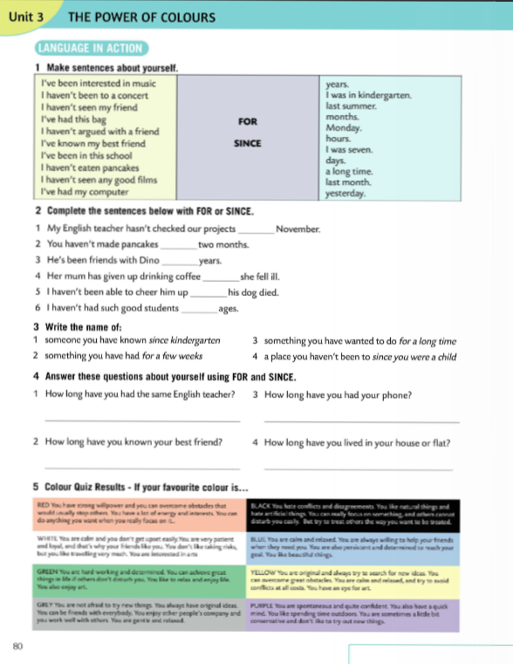
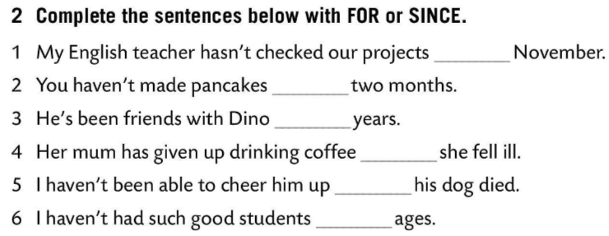
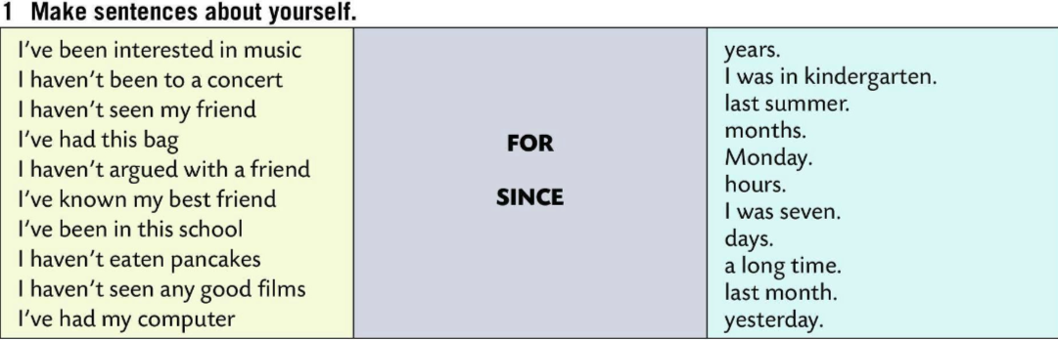
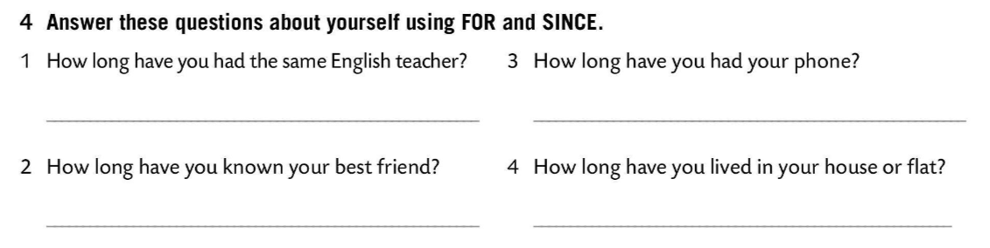
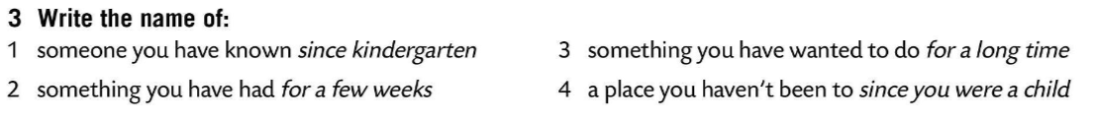
Make sentences about yourself. Write in your notebook.
Complete the sentences below with FOR or SINCE.
SINCE
Check.
FOR
FOR
SINCE
Write the name of…
SINCE
FOR
Present your answers to the class.
Answer the questions in Task 4 using FOR and SINCE.

Slide 10
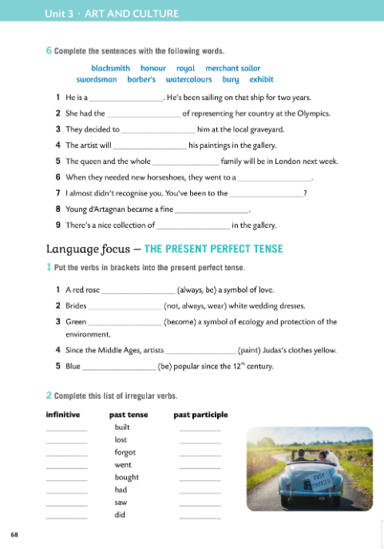
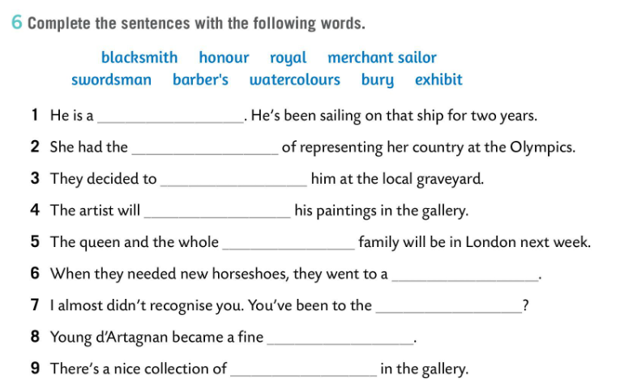
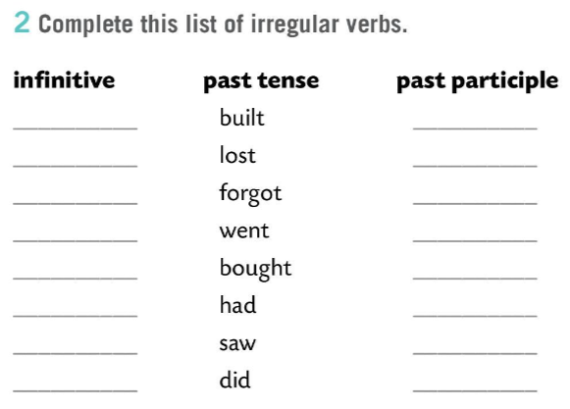
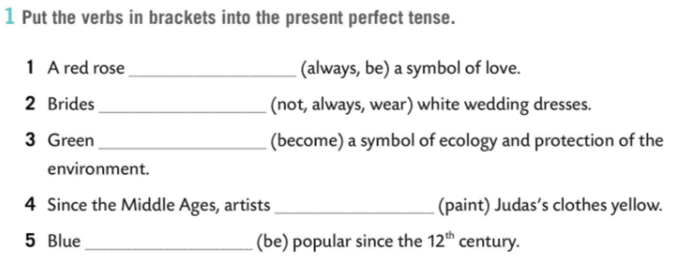
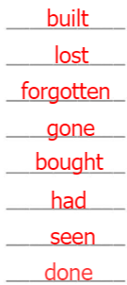
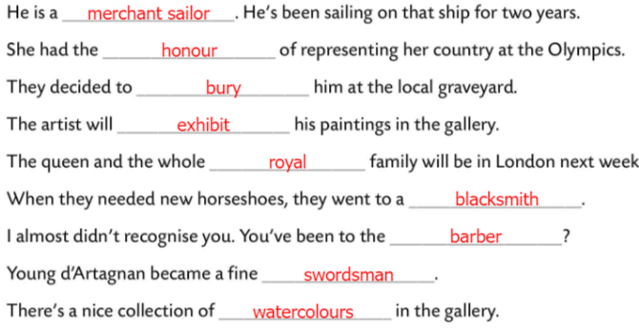
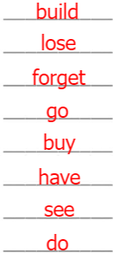
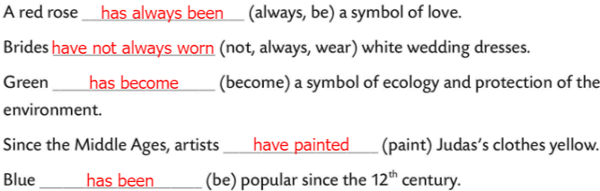
Workbook, page 68
Complete the sentences with the words from Task 6.
Check.
Put the verbs in brackets into the present perfect tense.
Check.
Complete this list of irregular verbs.
Check.

Slide 11
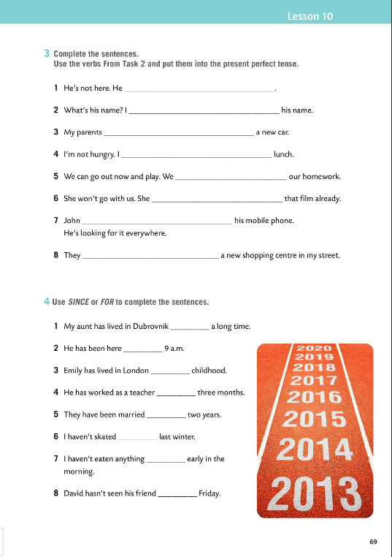
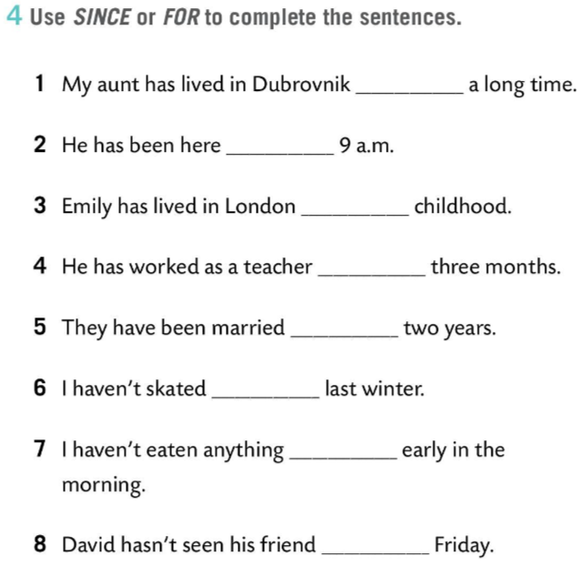
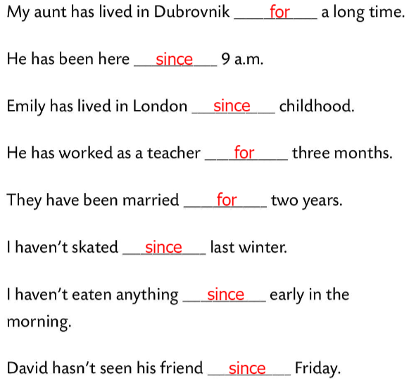
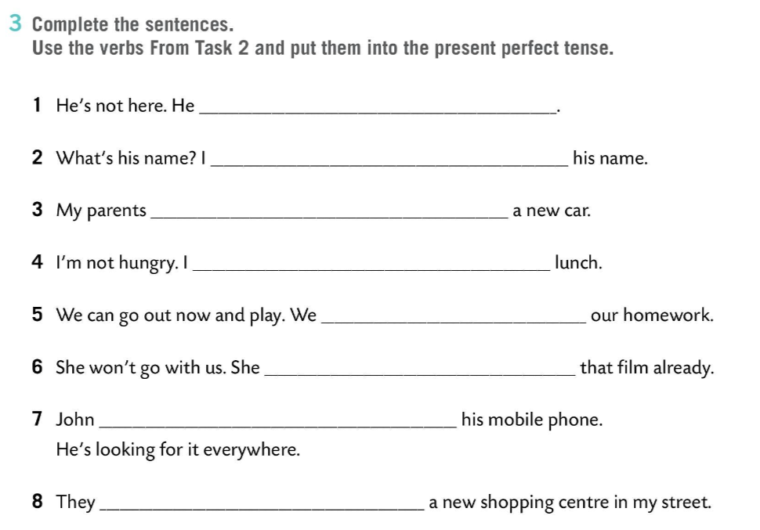
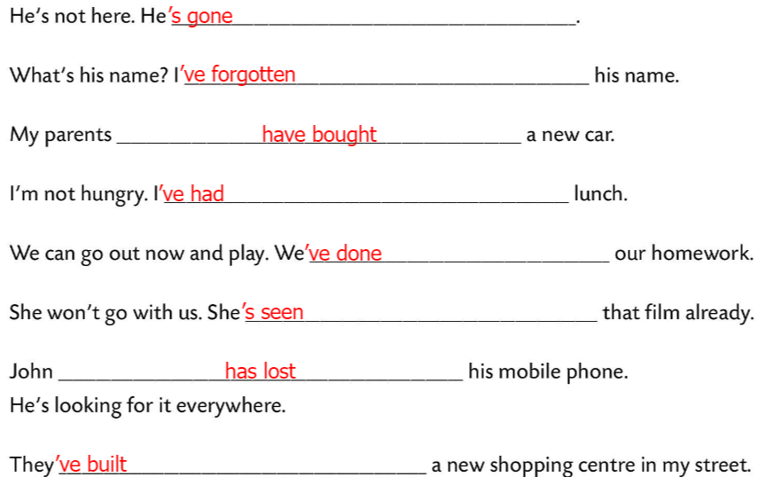
Workbook, page 69
Complete the sentences. Use the verbs from Task 2 and put them into the present perfect tense.
Check.
Use SINCE or FOR to complete the sentences.
Check.

Slide 12
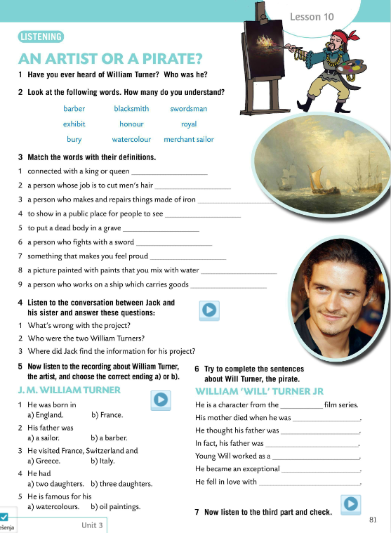
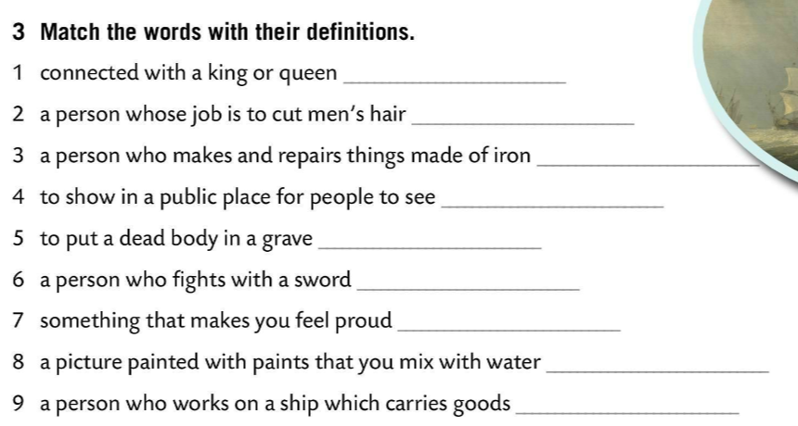


Have you ever heard of William Turner? Who was he?
Look at the following words. How many do you understand?
barber – brijač
blacksmith – kovač
swordsman – mačevalac
exhibit – izložiti
honour – čast
royal – kraljevski
bury - pokopati
watercolour – vodene boje
merchant sailor – pomorski trgovac
royal
barber
balcksmith
Match the words with their definitions.
exhibit
Jack mixed up the two William Turners.
bury
One was an artist and the other was a pirate.
swordsman
He found it on the Internet.
Check.
honour
watercolour
merchant sailor
Listen to the conversation between Jack and his sister. Answer these questions.
Check.

Slide 13


Listen to the recording about William Turner, the artist, and choose the correct ending a) or b).
Check.
Try to complete the sentences about Will Turner the pirate.
Pirates of the Caribbean
12 years old.
respectable merchant sailor
Check.
the pirate William Bootstrap Bill
blacksmith
swordsman
Match the opposites! https://wordwall.net/play/849/237/950
Elizabeth Swan

Slide 14




Workbook, page 70
Complete the sentences. Try to make them as true as possible.
Check.
Use SINCE or FOR to complete the sentences.
Check.

